Slide 1
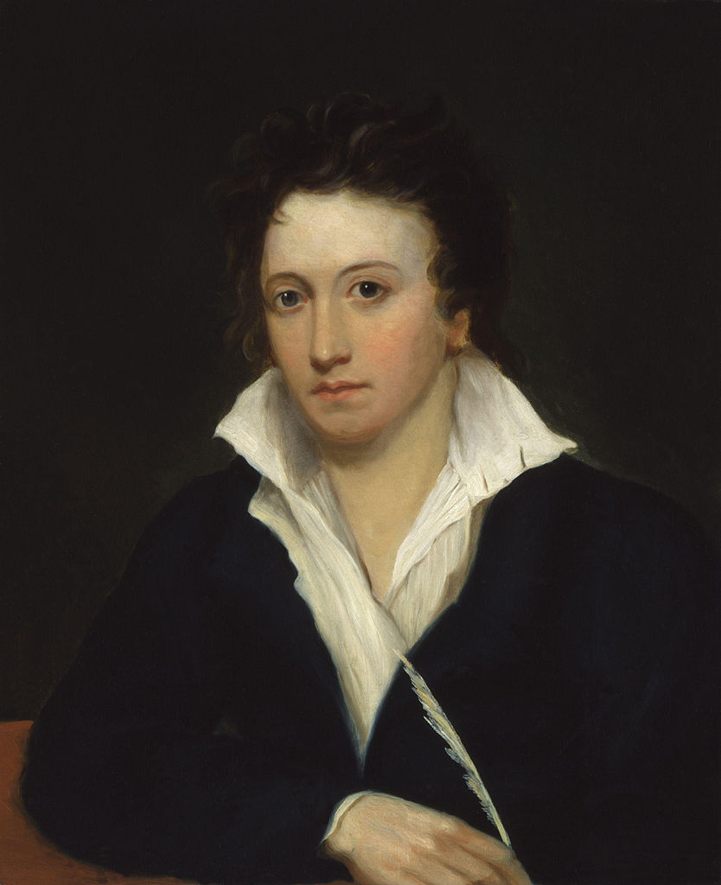
Percy Bysshe Shelley （August 1792 – 8 July 1822) was one of the major English Romantic poets. A radical in his poetry as well as in his political and social views.

Slide 2
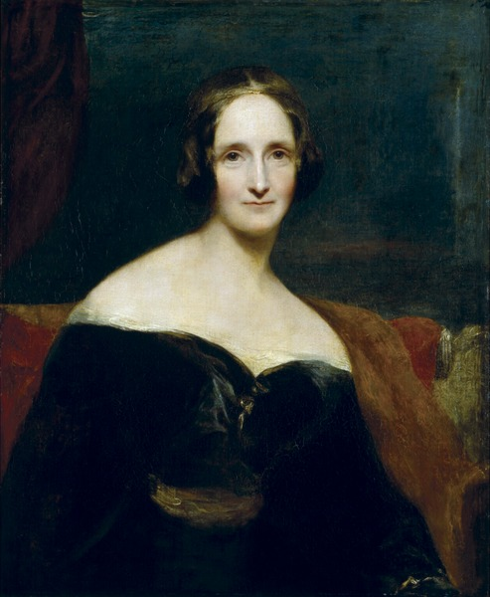
Mary Wollstonecraft Shelley; (30 August 1797 – 1 February 1851) was an English novelist who wrote the Gothic novel Frankenstein; or, The Modern Prometheus (1818), which is considered an early example of science fiction..

Slide 3
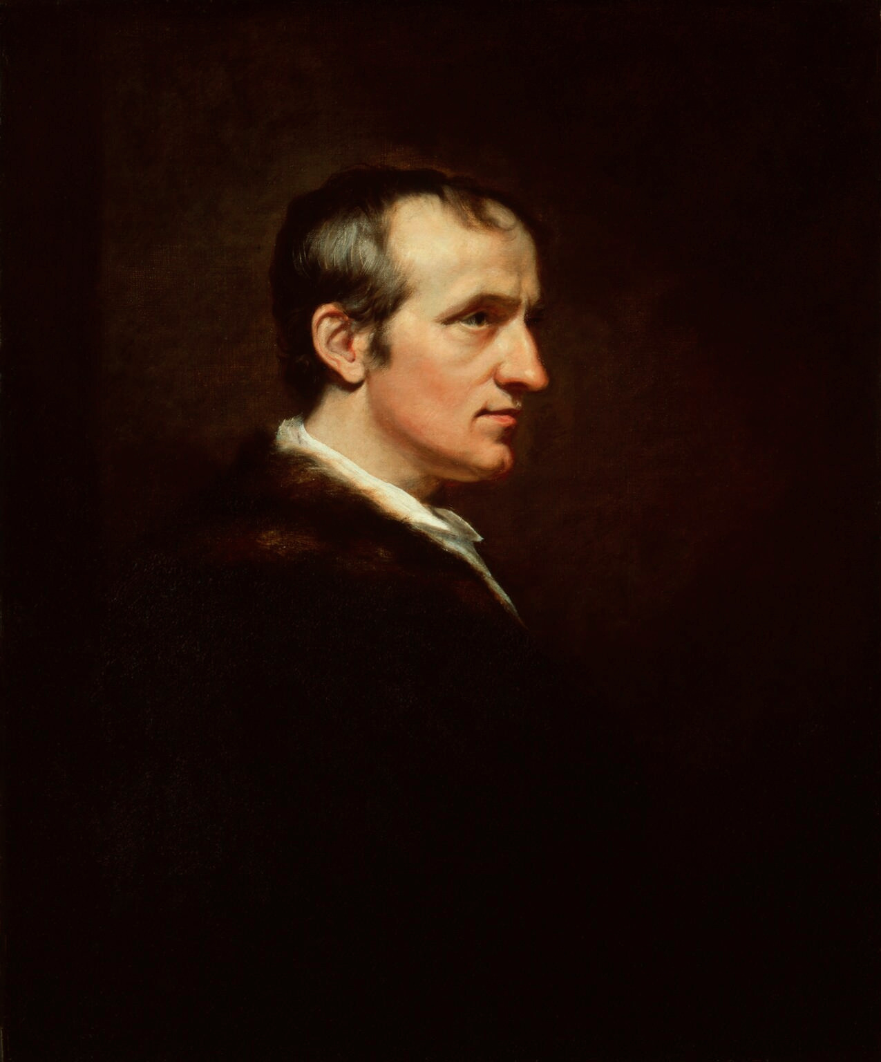
William Godwin (3 March 1756 – 7 April 1836) was an English journalist, political philosopher and novelist. He is considered one of the first exponents of utilitarianism and the first modern proponent of anarchism.

Slide 4
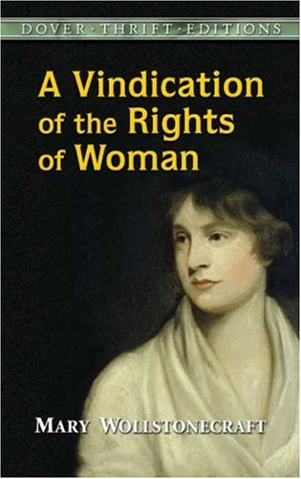
Mary Wollstonecraft (27 April 1759 – 10 September 1797) was an English writer, philosopher, and advocate of women‘s rights. Today Wollstonecraft is regarded as one of the founding feminist philosophers.

Slide 5
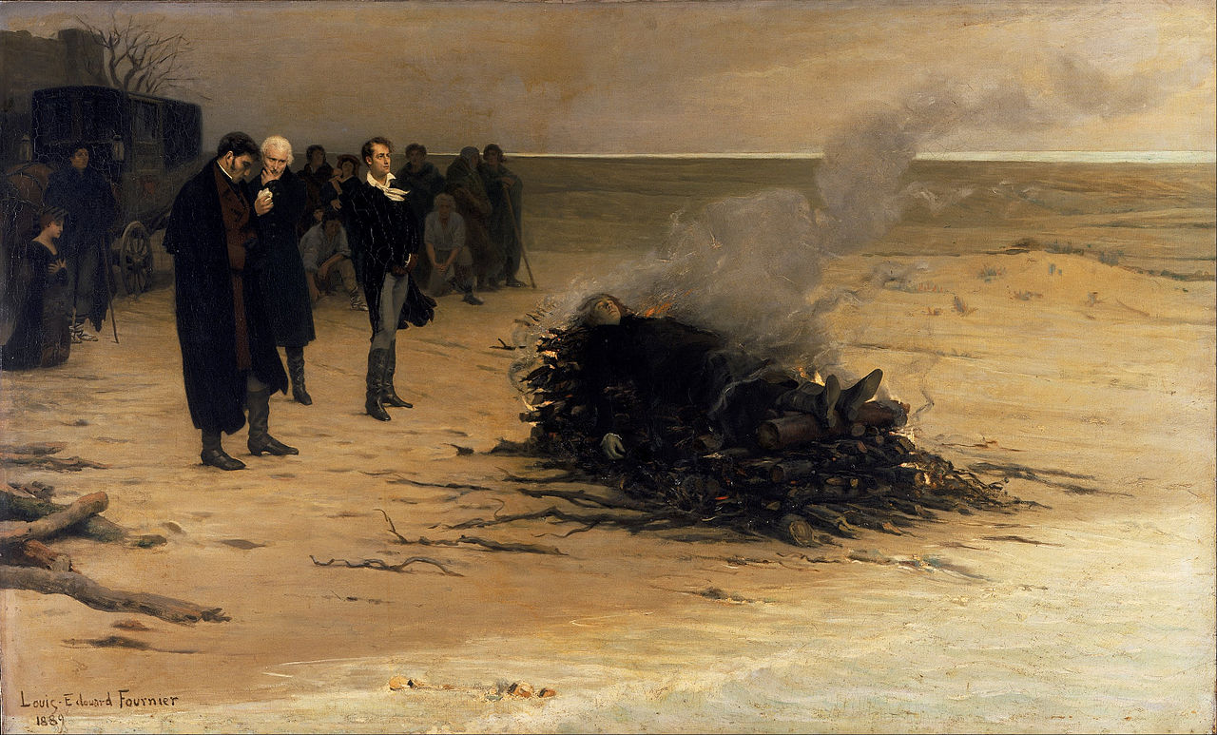

Slide 6
His wan eyes
Gaze on the empty scene as vacantly
As ocean’s moon looks on the moon
In heaven.
--Alastor line 200-202

Slide 7
Shelley, the writer of some infidel poetry, has been drowned; now he knows whether there is God or no.

Slide 8
How I, then a young girl, came to think of, and to dilate upon, so very hideous an idea?
— Mary Shelley

